Slide 1
Machine Learning DSECL ZG565
Dr. Chetana Gavankar, Ph.D,
IIT Bombay-Monash University Australia
Chetana.gavankar@pilani.bits-pilani.ac.in

Slide 2
Lecture No. – 6 | Linear Regression
Date – 4/10/2020
Time – 02:00 PM – 4:00 PM

Slide 3
Session Content
Regression (Andrew Ng Notes)
Bayesian linear regression (6.4 Tom Mitchell)
Linear basis function models (3.1 Bishop)

Slide 4
Regression
So far, we’ve been interested in learning P(Y|X) where Y has discrete values (called ‘classification’)
What if Y is continuous? (called ‘regression’)
predict weight from gender, height, age, …
predict Google stock price today from Google, Yahoo, MSFT prices yesterday
predict each pixel intensity in robot’s current camera image, from previous image and previous action

Slide 5
Regression
Wish to learn f : X → Y , where Y is real, given {<x¹,y¹>…<x^{n},y^{n}>}
Geometric Approach
Least squares function fitting given {<x¹,y¹>…<x^{n},y^{n}>}
Bayesian Approach
Choose some parameterized form for P(Y|X; θ)
( θ is the vector of parameters)
Derive learning algorithm as MCLE estimate for θ

Slide 6
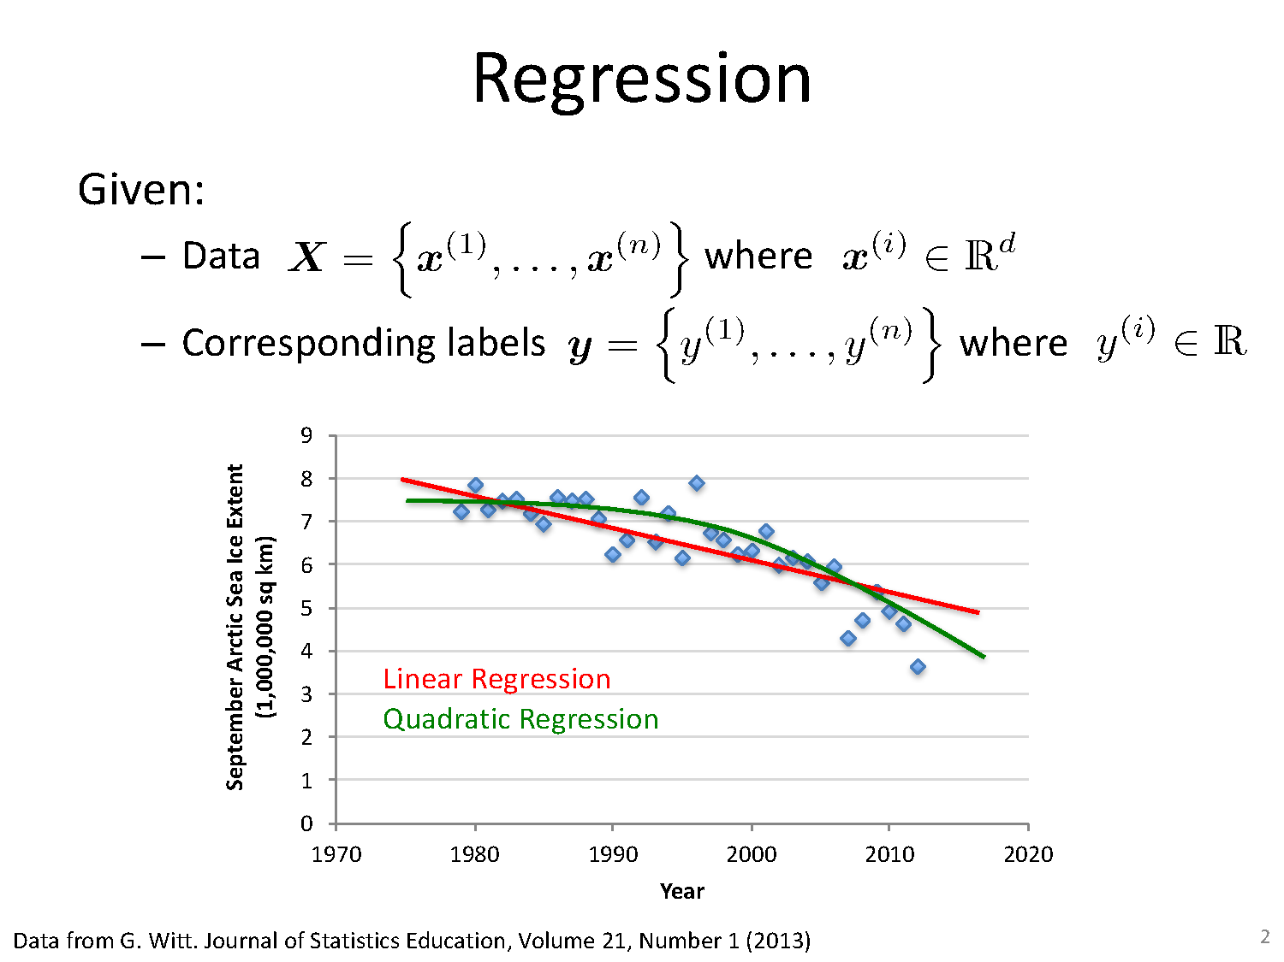
Geometric Approach

Slide 7
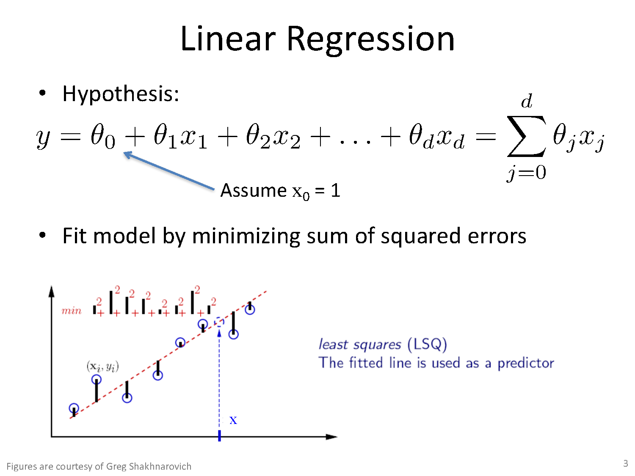

Slide 8
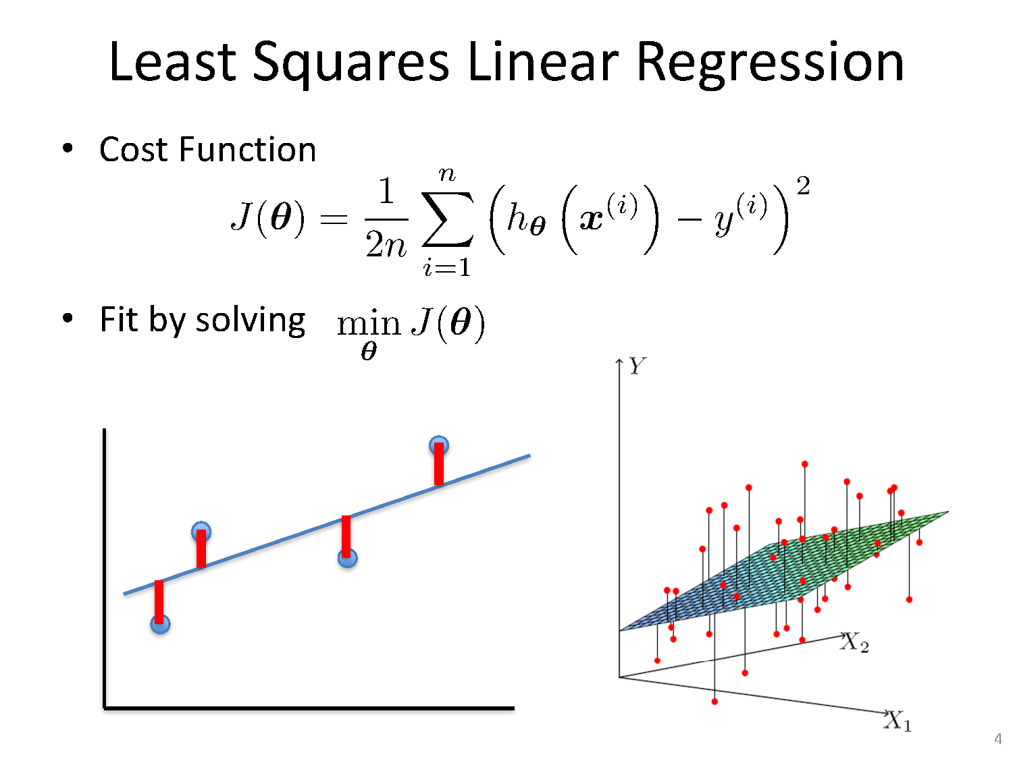

Slide 9
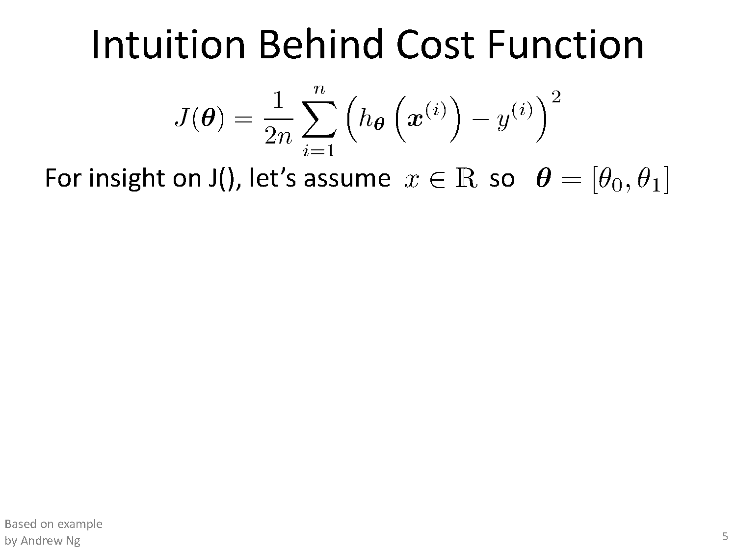

Slide 10
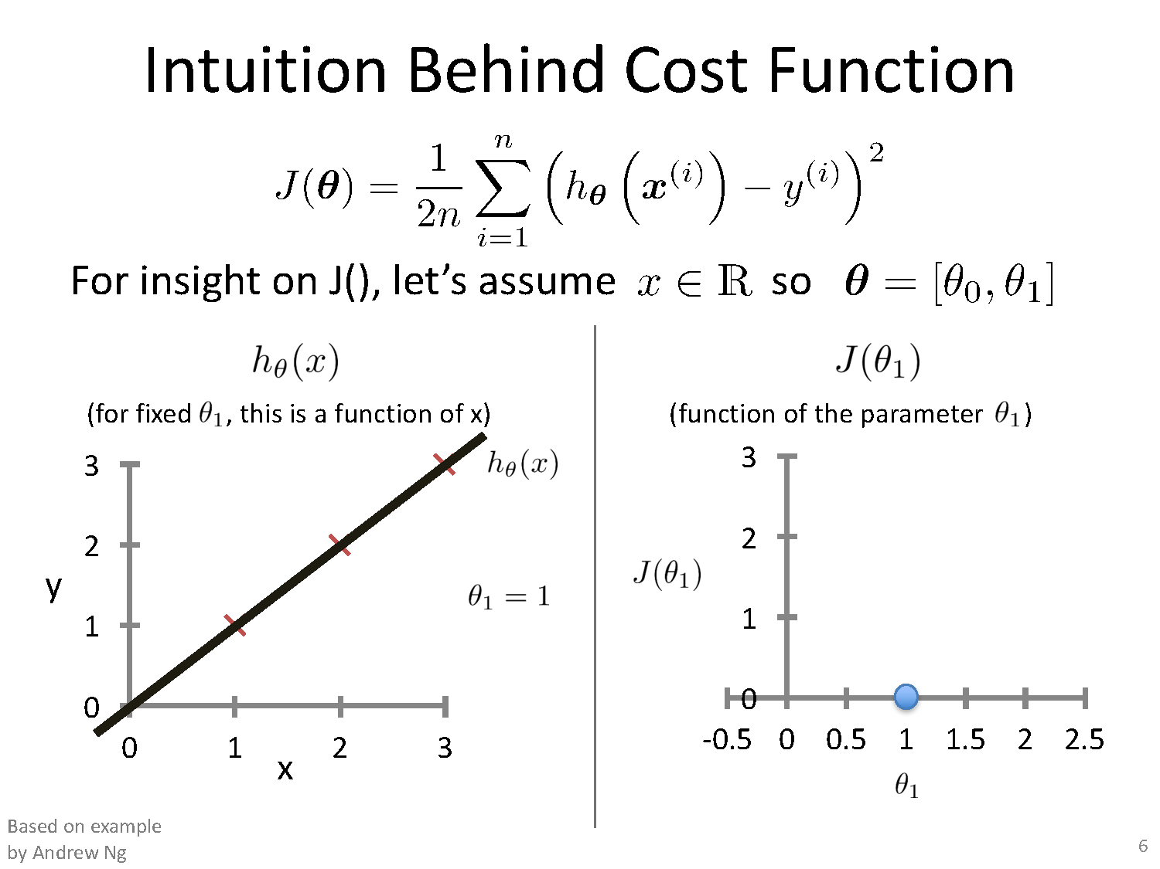

Slide 11
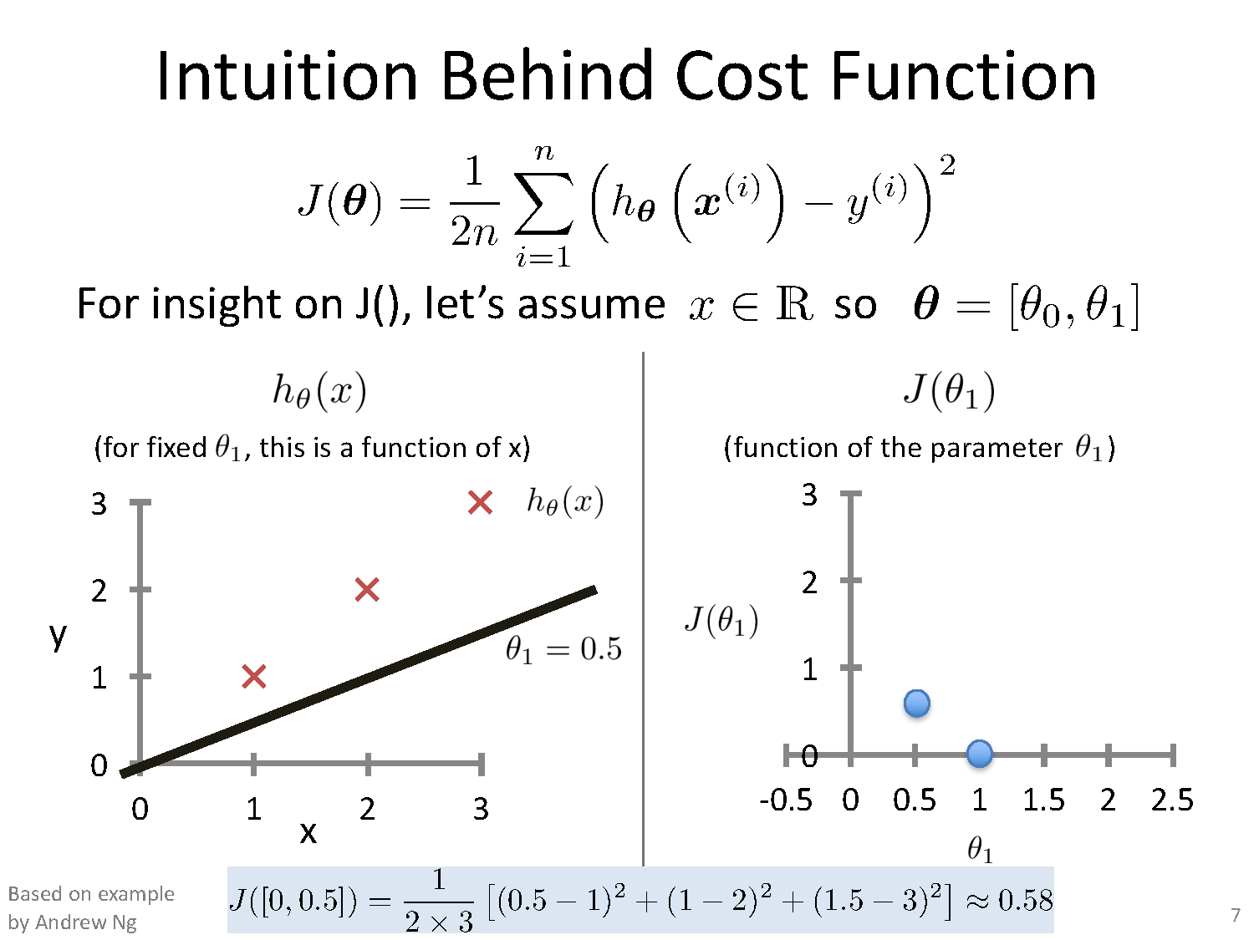

Slide 12
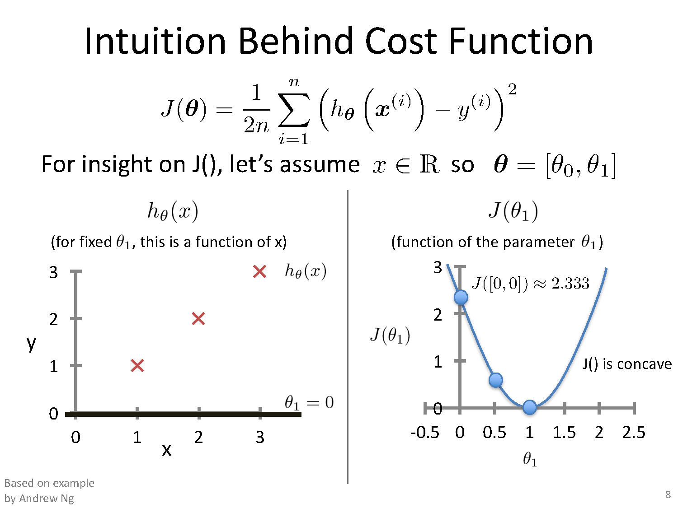

Slide 13
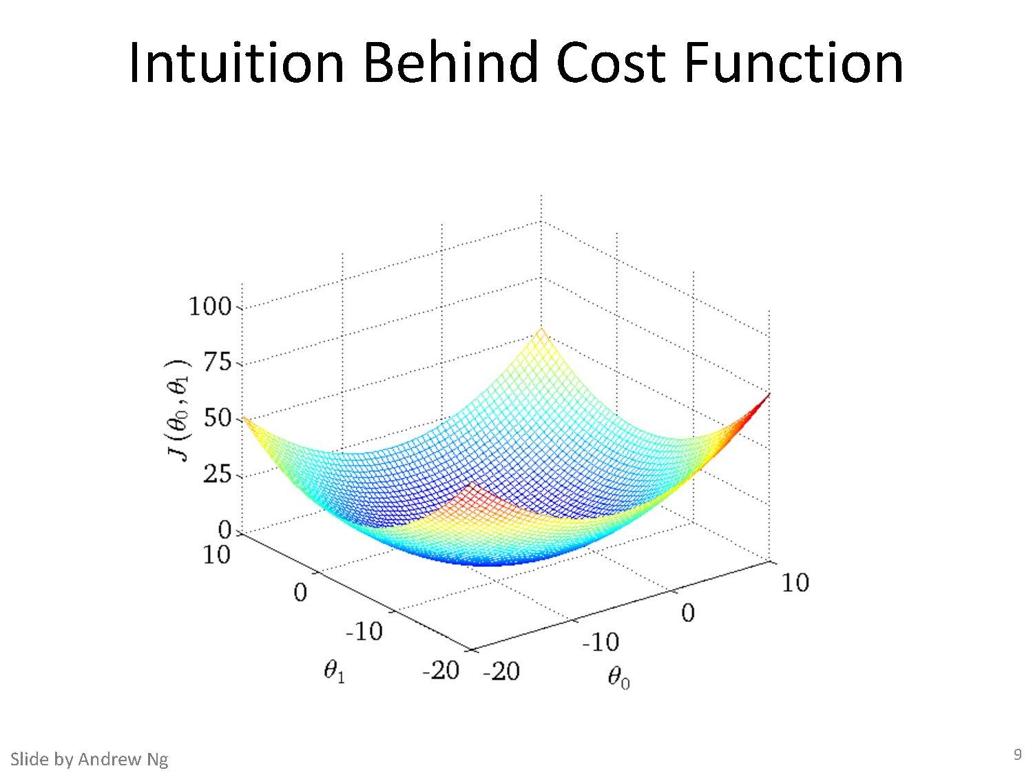

Slide 14
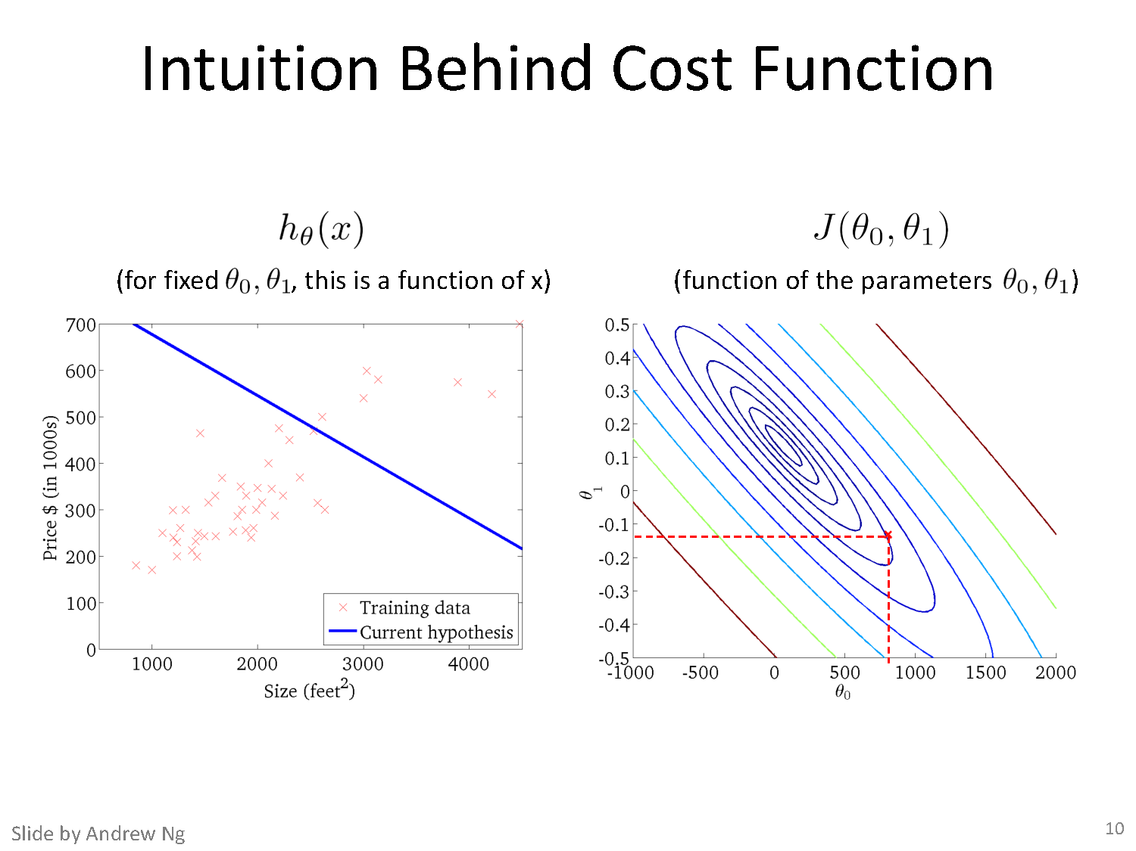

Slide 15
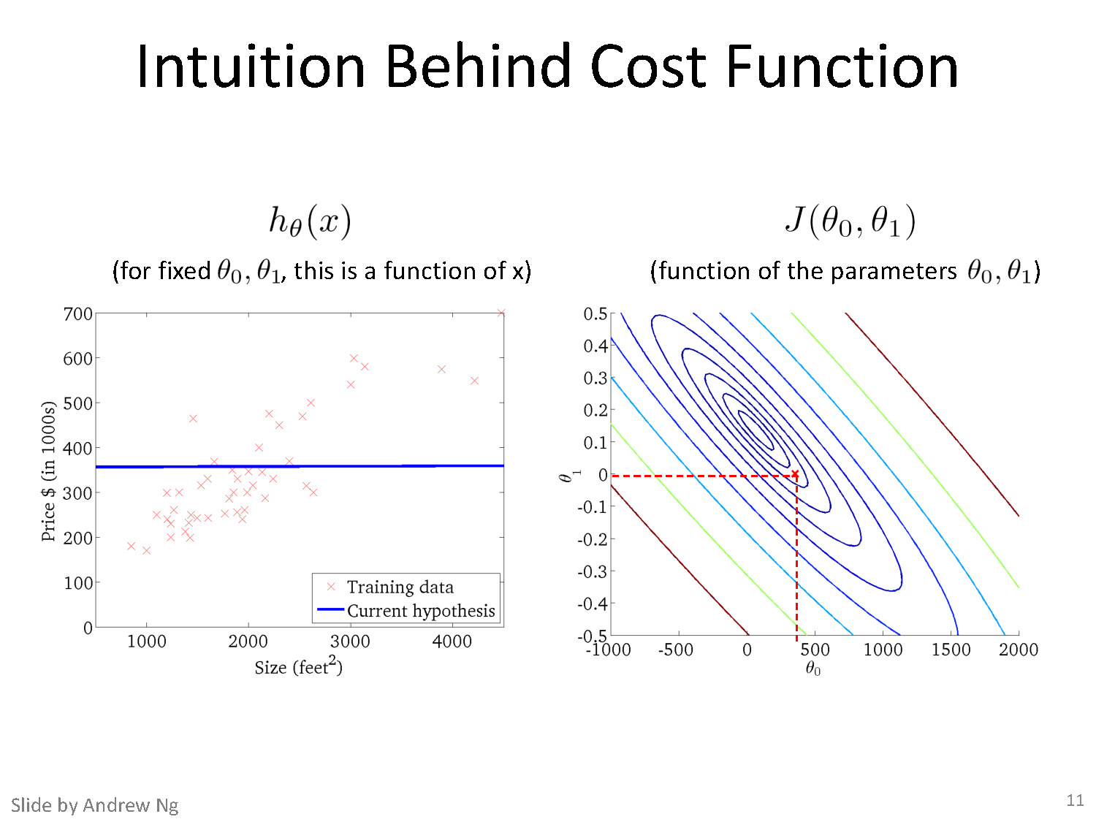

Slide 16
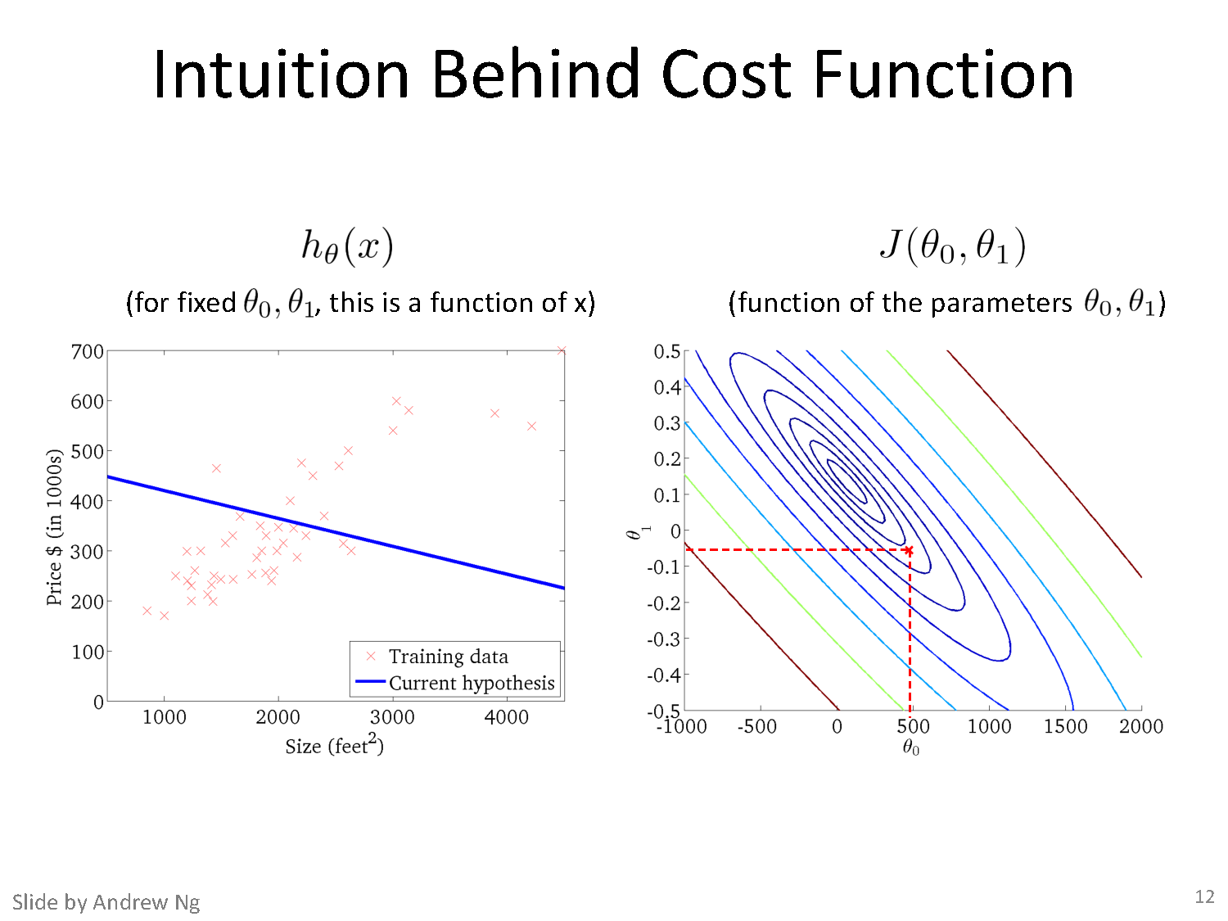

Slide 17
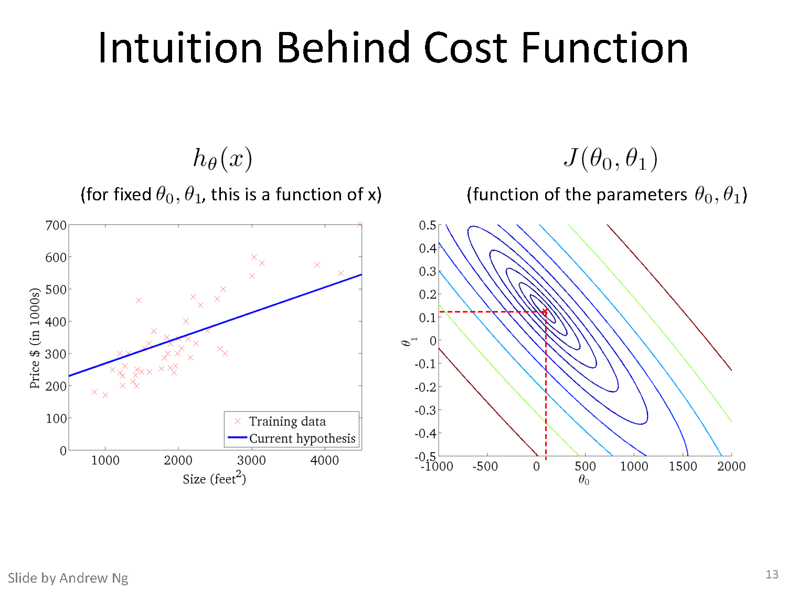

Slide 18
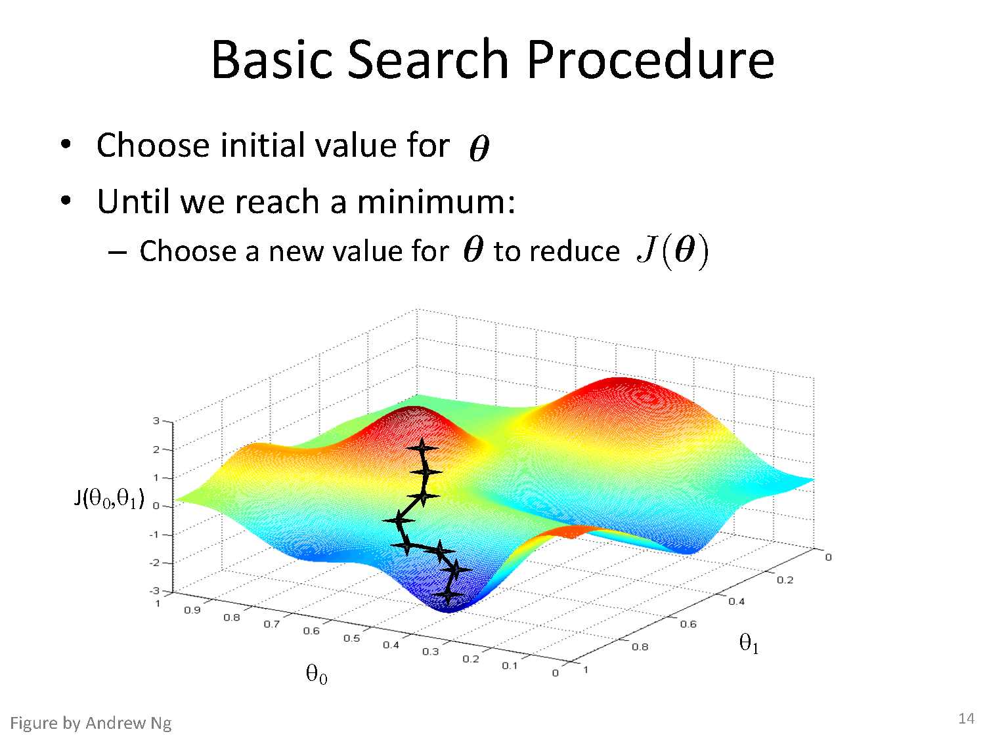

Slide 19
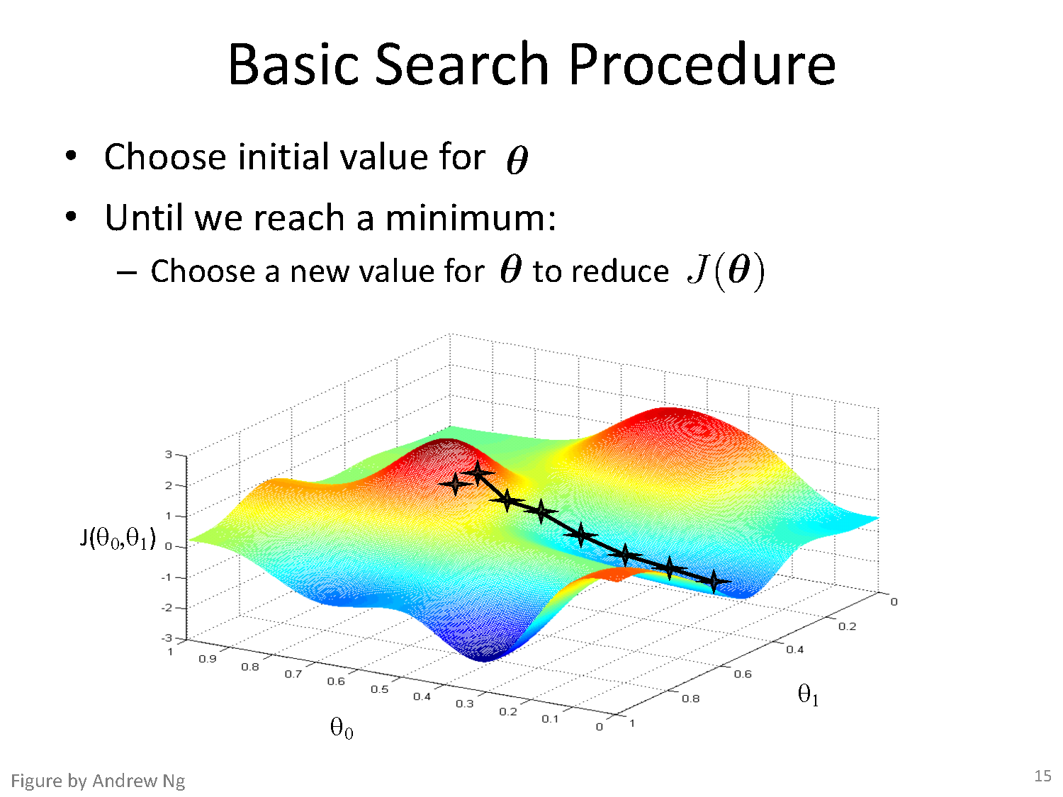

Slide 20
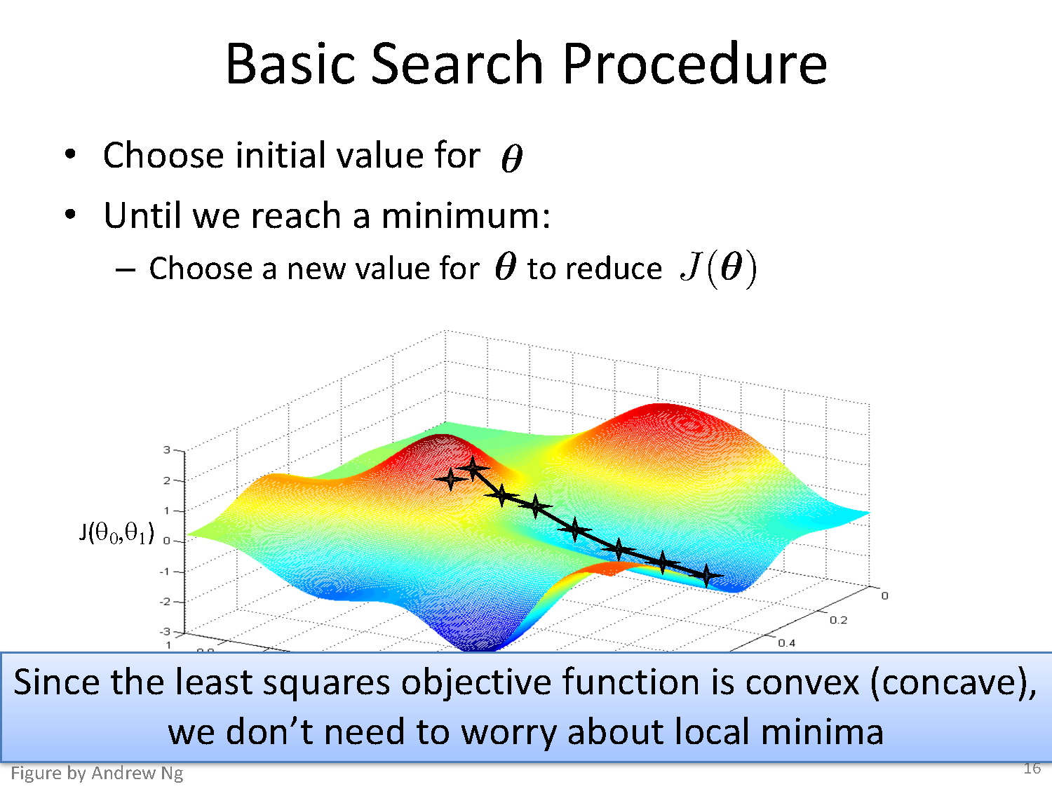

Slide 21
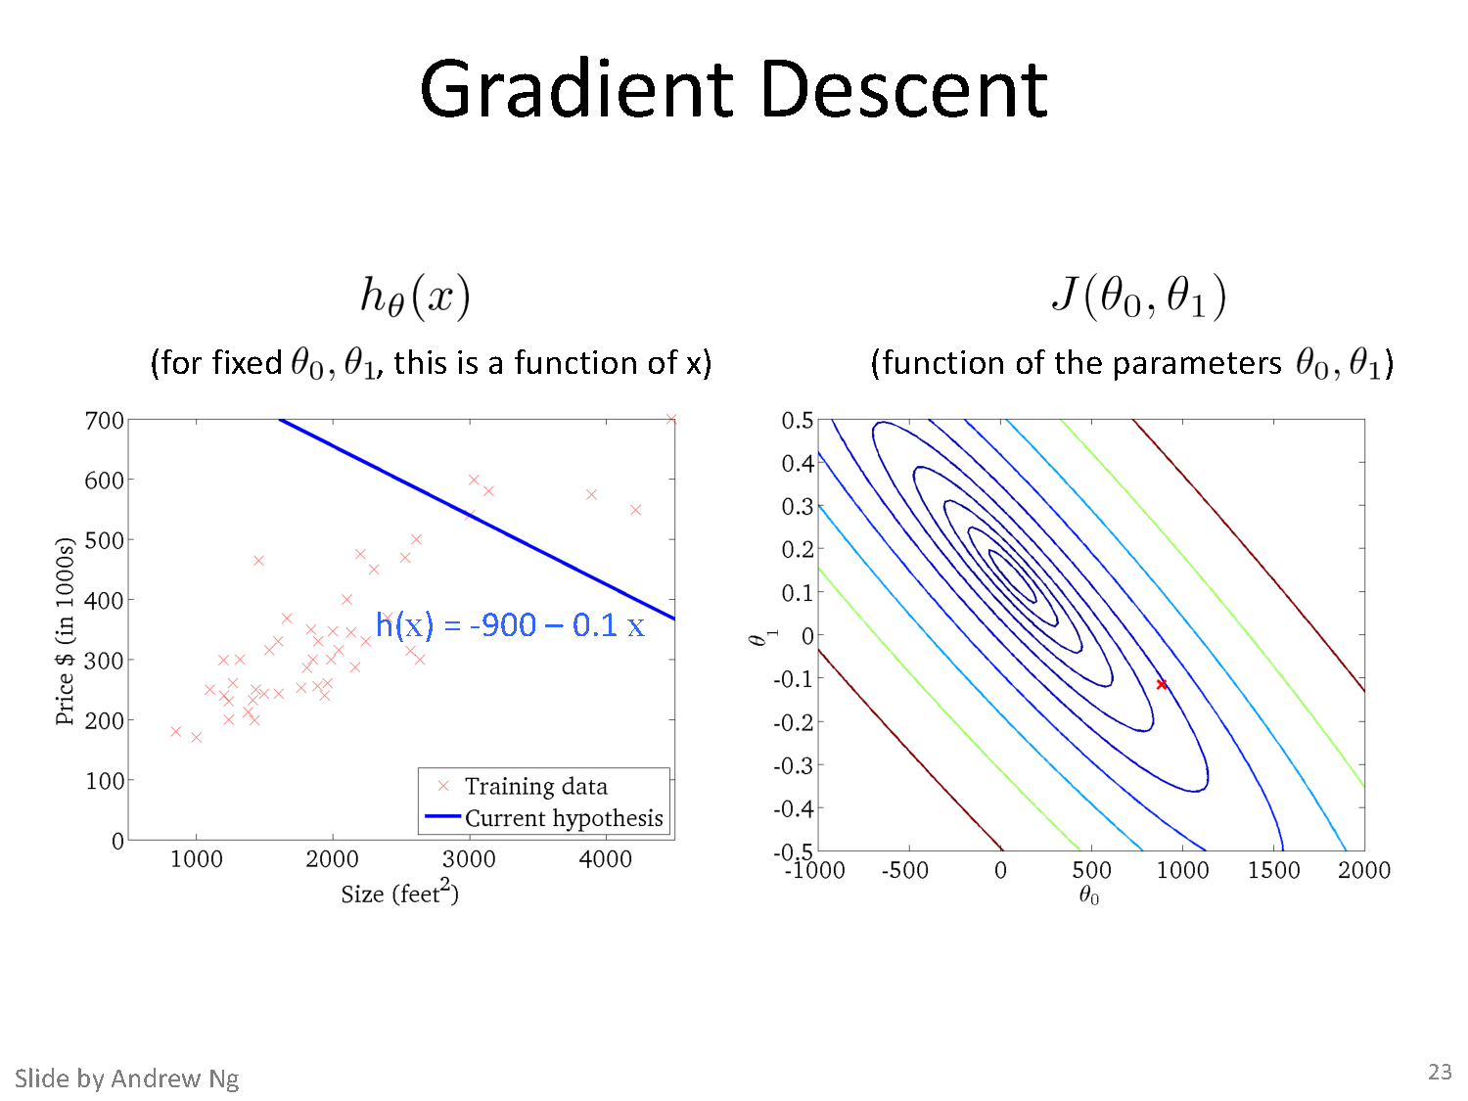

Slide 22
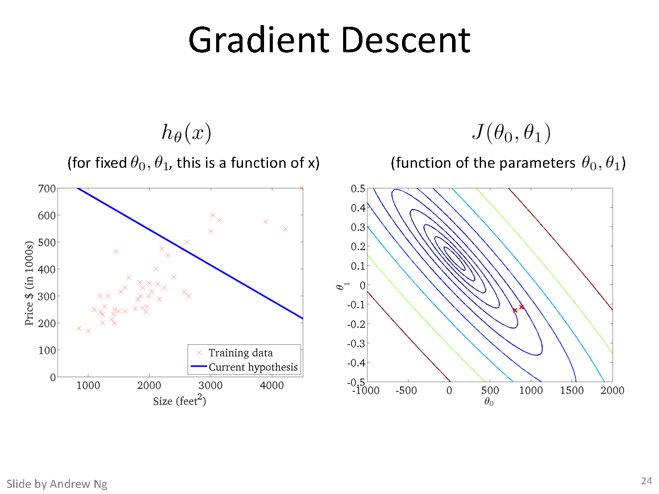

Slide 23
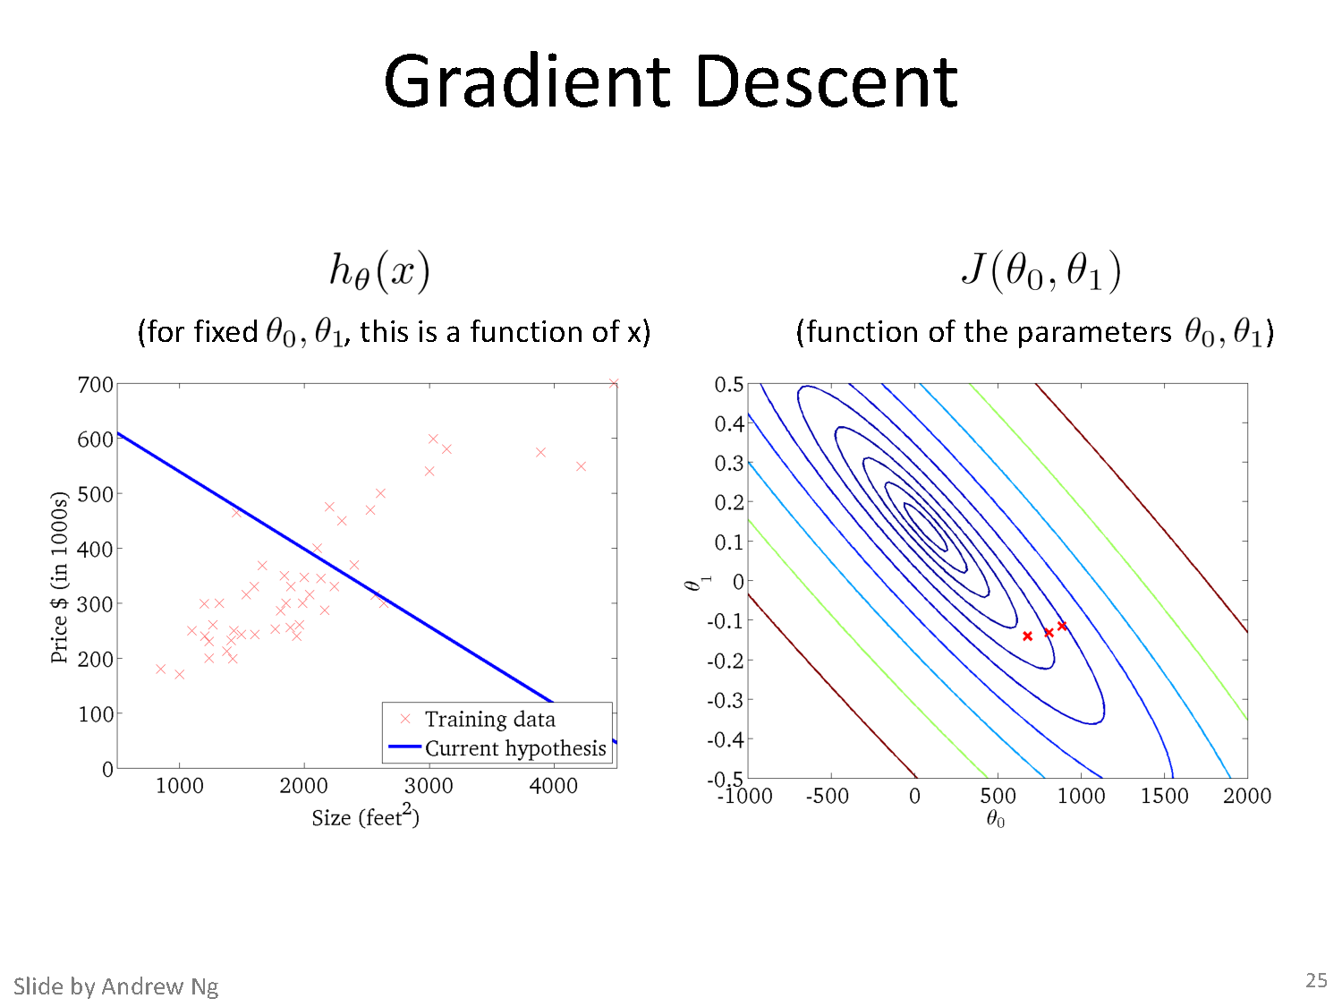

Slide 24
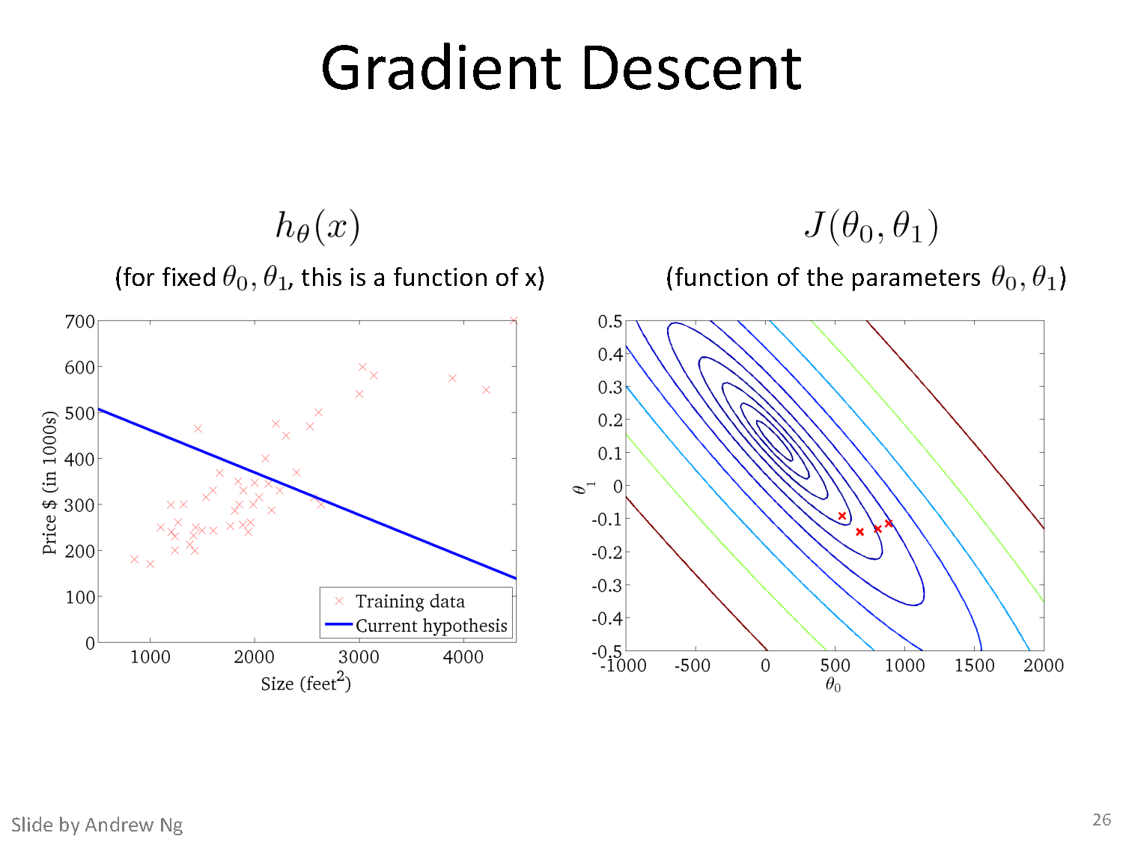

Slide 25
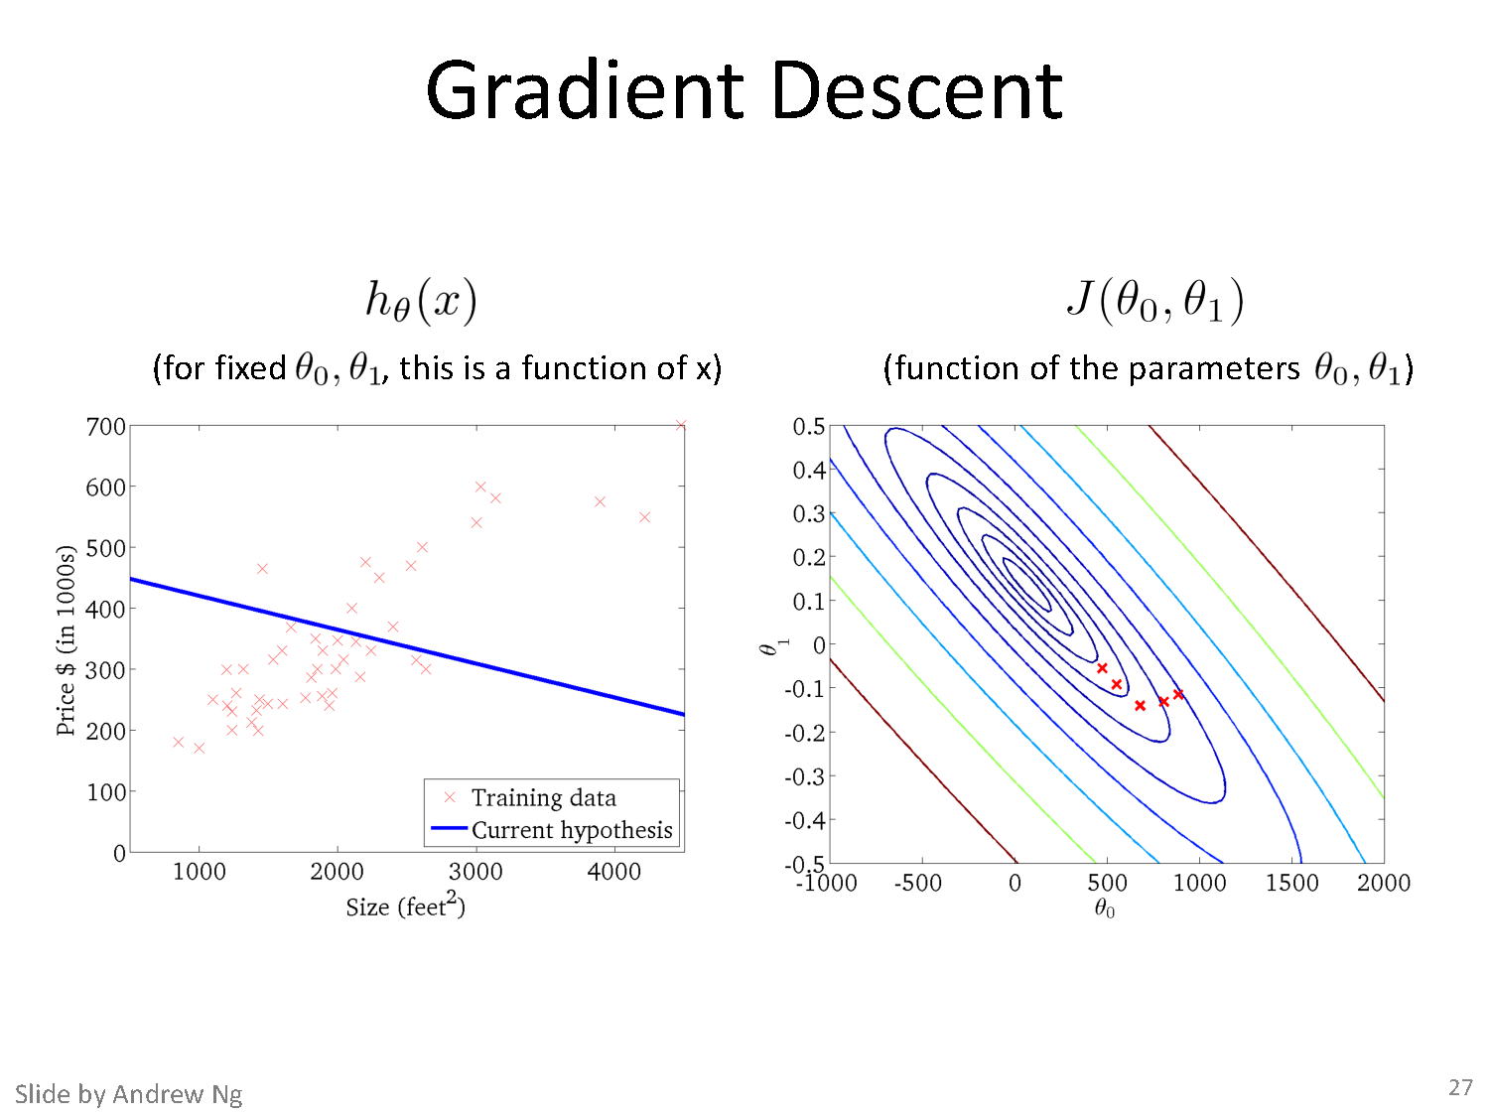

Slide 26
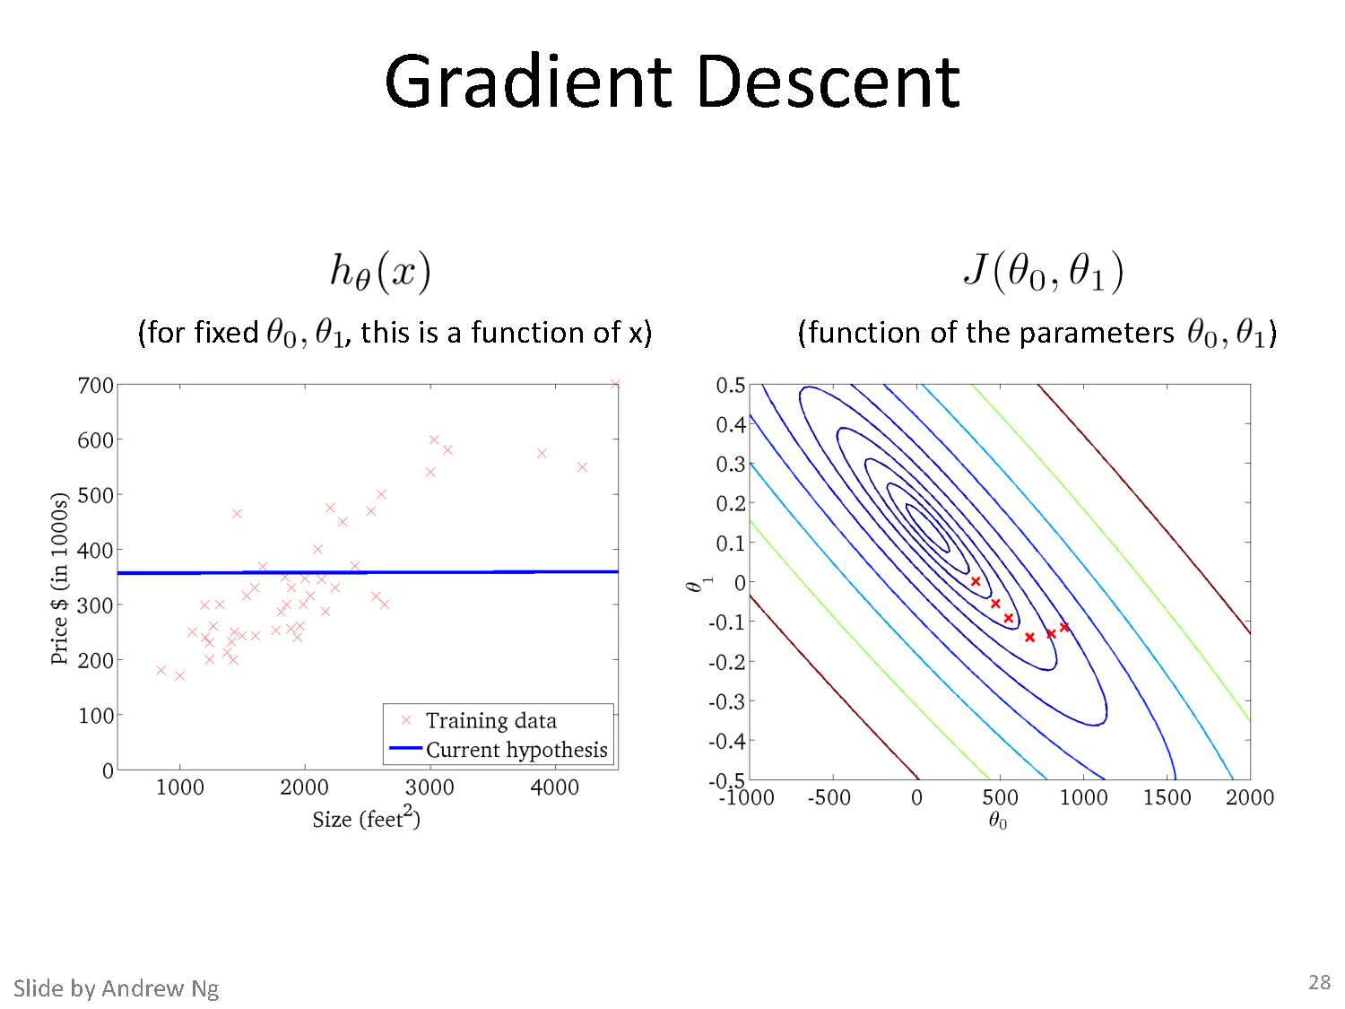

Slide 27
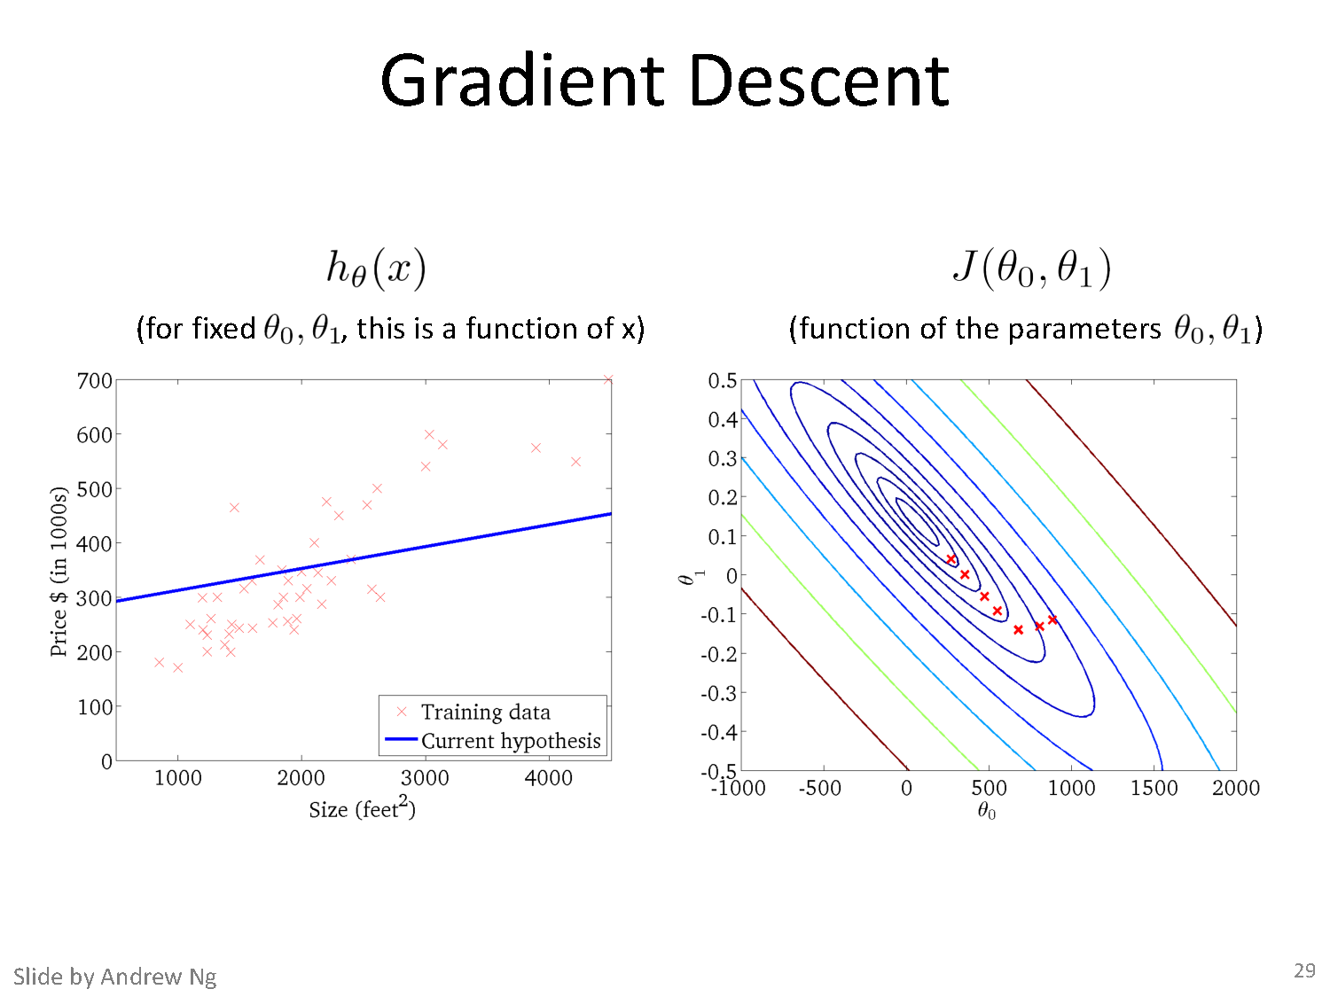

Slide 28
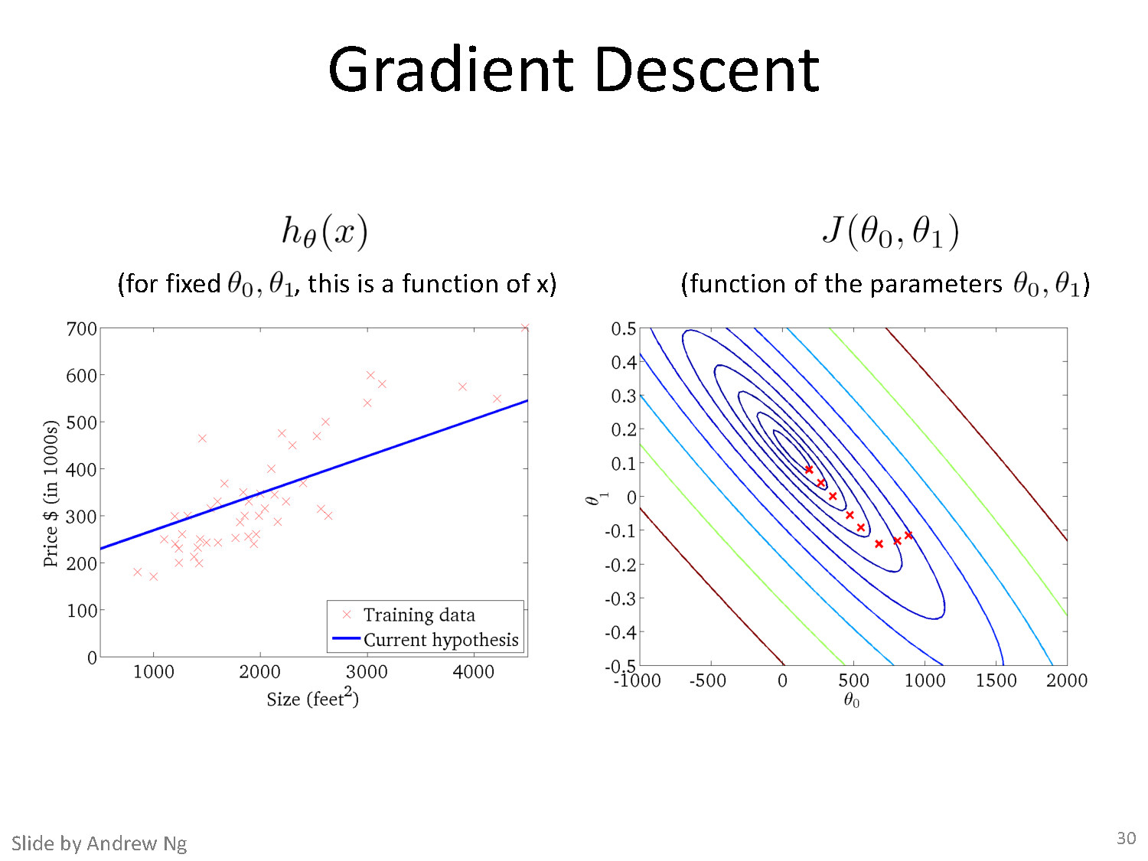

Slide 29
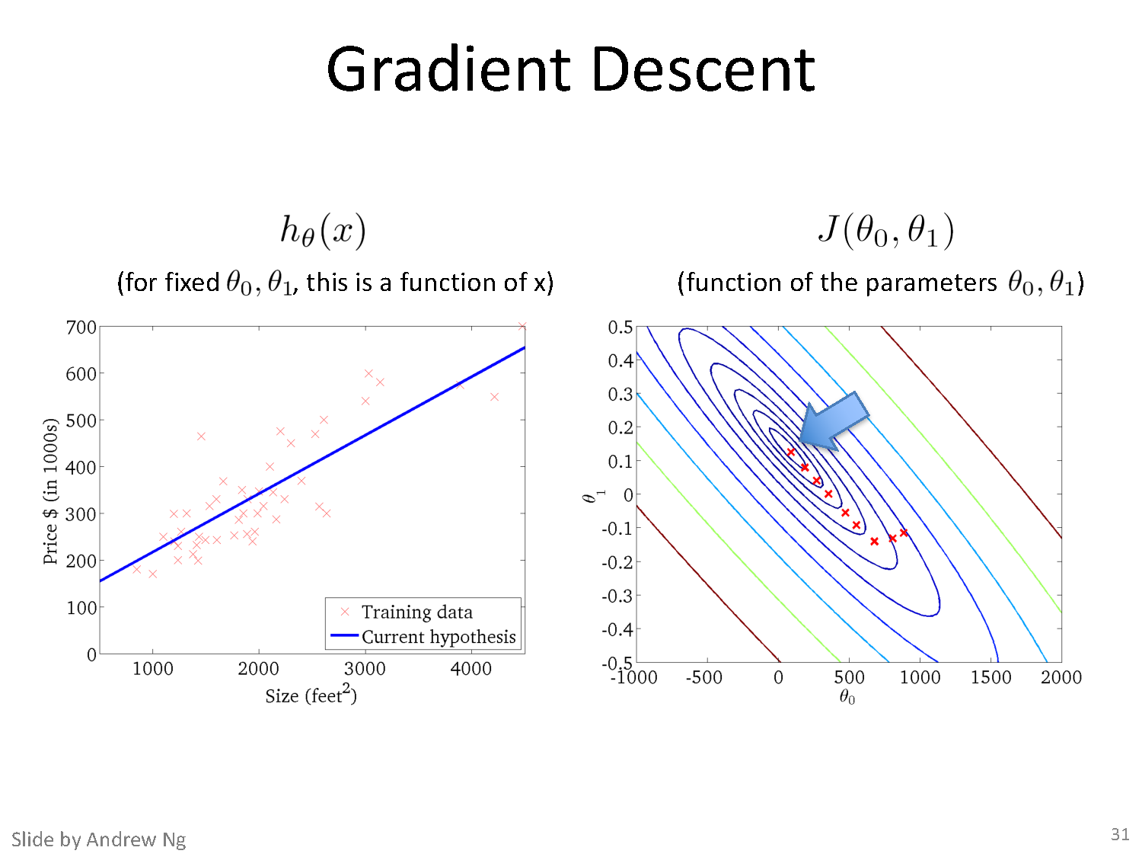

Slide 30
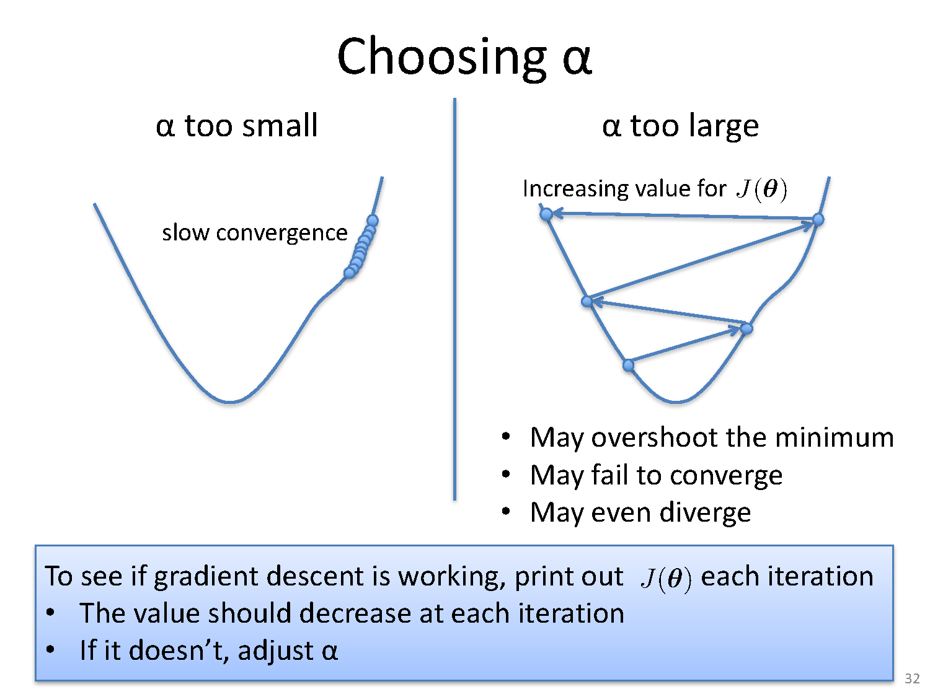

Slide 31
Gradient Descent: Loss with only one parameter θ₁
Slope = tan θ
tan θ > 0
; 0 < θ < 90
Slope = tan θ
tan θ < 0
; 90 > θ < 180

Slide 32
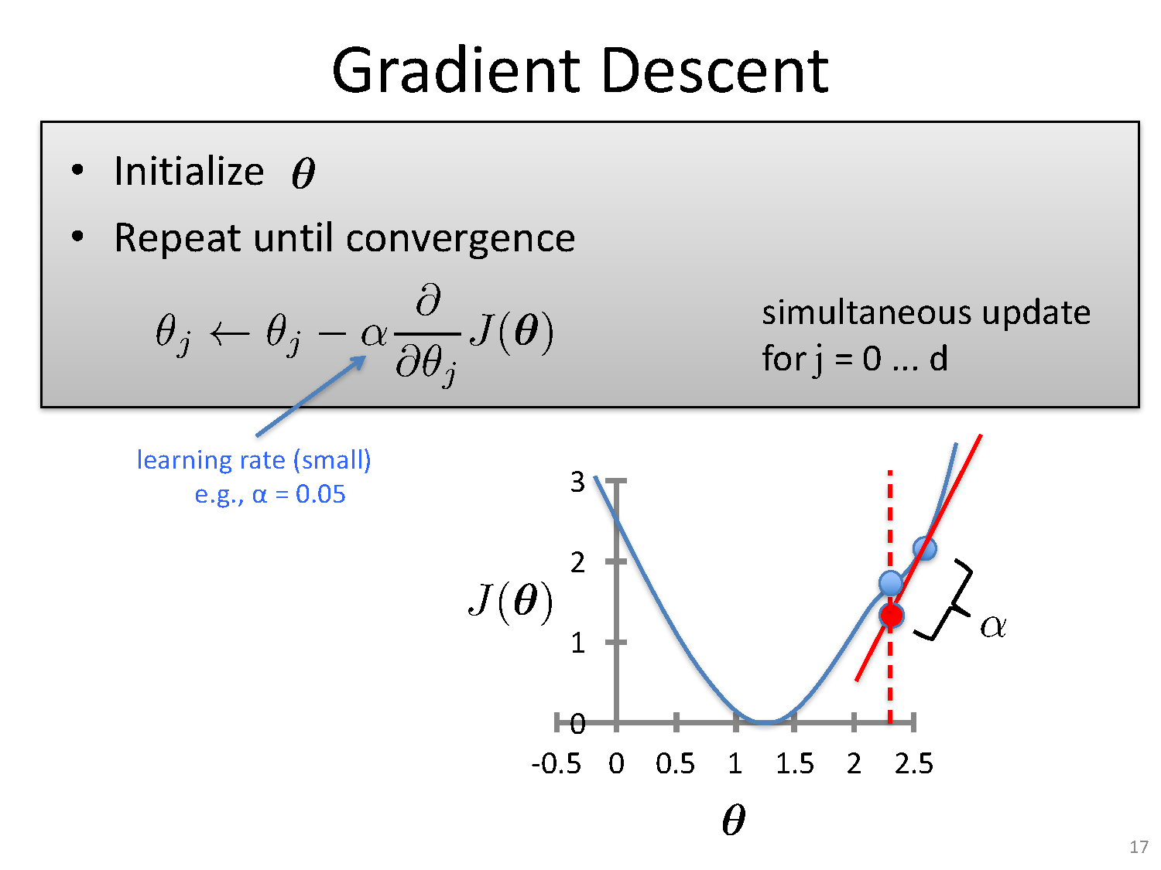

Slide 33
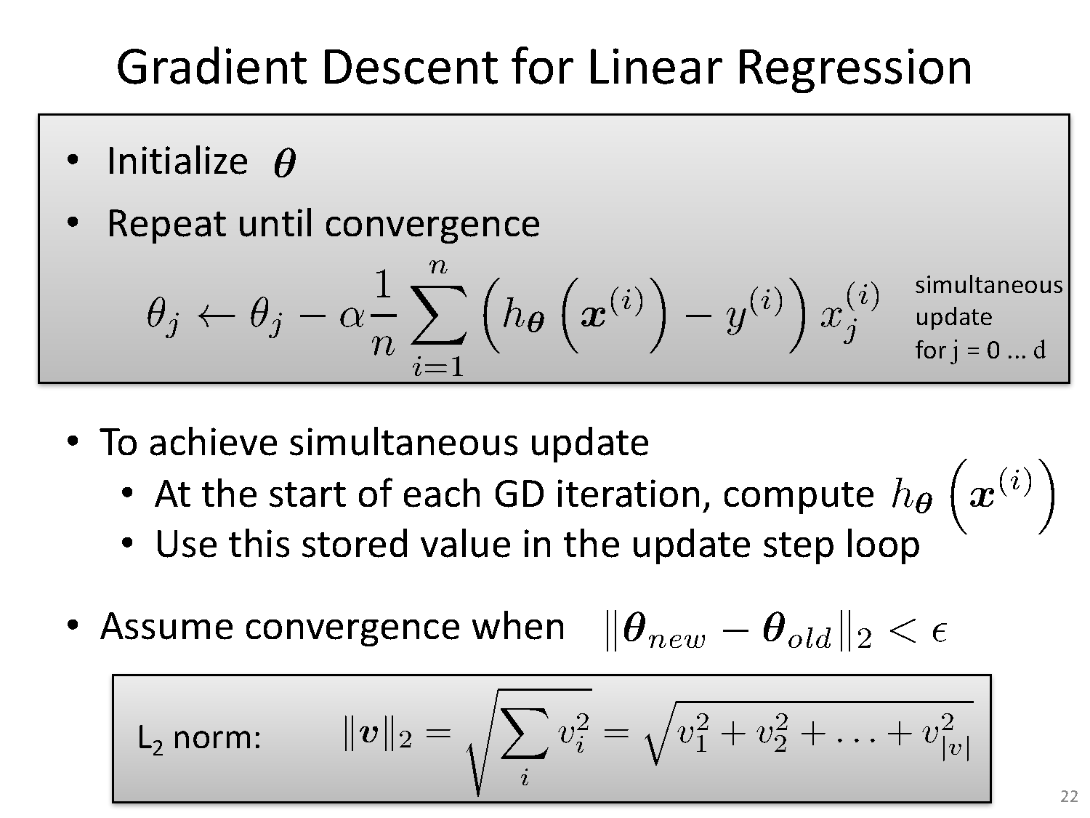

Slide 34
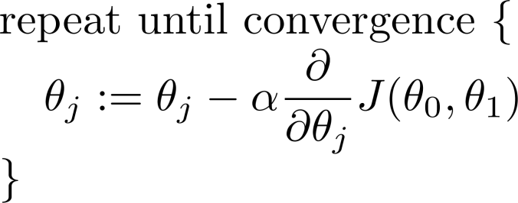
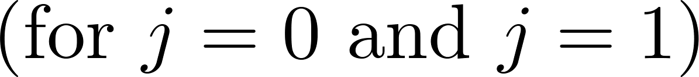
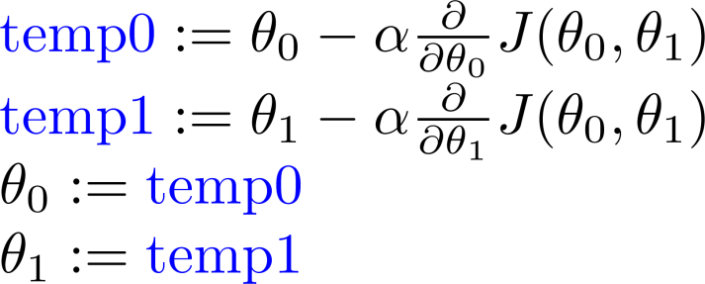
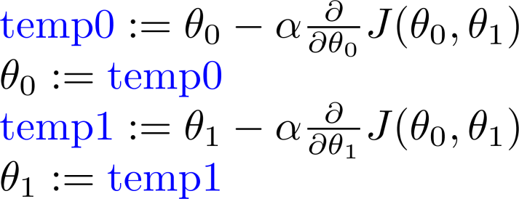
Gradient descent algorithm:
Simultaneous update
Correct: Simultaneous update
Incorrect:

Slide 35
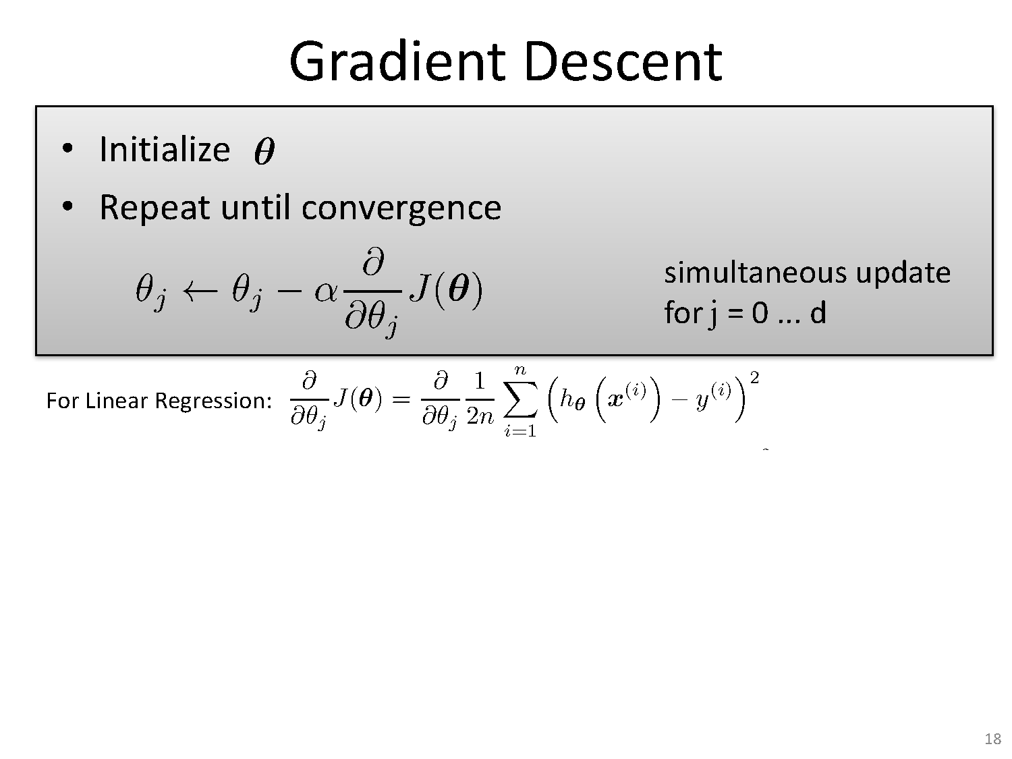

Slide 36
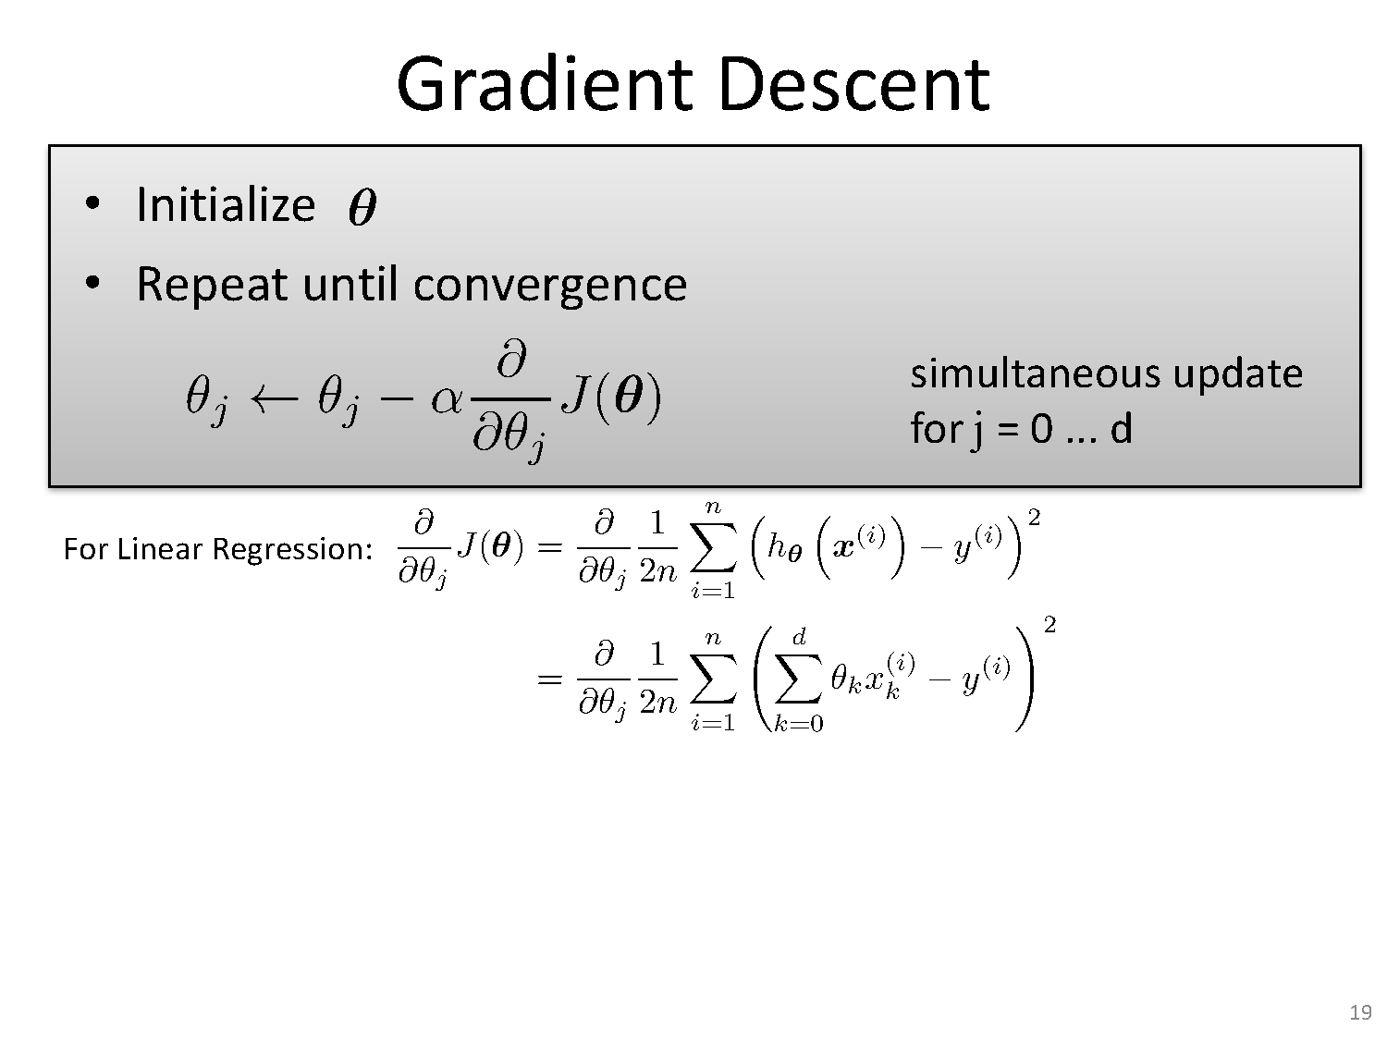

Slide 37
Gradient Descent algorithm:
learning rate/ η (eta) /α (alpha) parameter
The learning rate value is a small real value such as 0.1, 0.001
The most commonly used rates are : 0.001, 0.003, 0.01, 0.03, 0.1, 0.3.
Try different values for your problem and see which works best.
Typically if you take high value of you may miss on minima and overshoot.
If you choose a very small eta, the algorithm will be very slow and will take many iterations to converge

Slide 39
Stochastic gradient descent
For i=1,…n

Slide 40
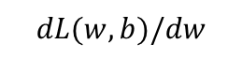
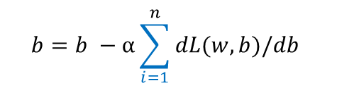
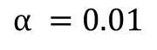
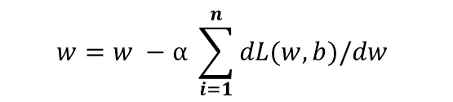
Gradient Descent (GD)
$$α =0.01$$
Initialize w and b randomly
for num_epochs do
Compute:
$$dL(w,b)/dw$$
and
$$dL(w,b)/db$$
$$w=w −α \sum_{i=1}^{n}{dL(w,b)/dw }$$
Update w:
$$b=b −α\sum_{i=1}^{n}{dL(w,b)/db }$$
Update b:
Print:
$$L(w,b)$$
// Useful to see if this is becoming smaller or not.
end

Slide 41
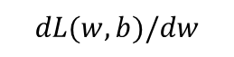
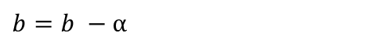
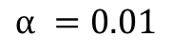

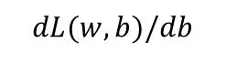
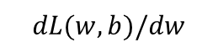
Stochastic Gradient Descent (GD)
$$α =0.01$$
Initialize w and b randomly
for num_epochs do
for i=1…n do
Compute:
$$dL(w,b)/dw$$
and
$$dL(w,b)/db$$
Update w:
$$dL(w,b)/dw$$
$$w=w −α$$
Update b:
$$dL(w,b)/db$$
$b=b −α$
Print:
$$L(w,b)$$
// Useful to see if this is becoming smaller or not.
end

Slide 42
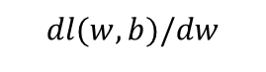
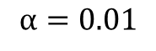
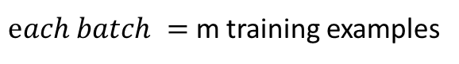
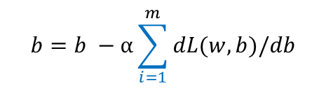
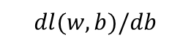
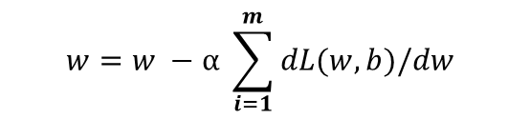
Mini-batch Gradient Descent
$$α=0.01$$
$each batch =$ m training examples
Initialize w and b randomly
for num_epochs do
for num_batches t=1…T do
Compute:
$$dl(w,b)/dw$$
and
$$dl(w,b)/db$$
$$w=w −α \sum_{i=1}^{m}{dL(w,b)/dw }$$
Update w:
$$b=b −α\sum_{i=1}^{m}{dL(w,b)/db }$$
Update b:
Print:
$$l(w,b)$$
// Useful to see if this is becoming smaller or not.
end
end

Slide 43
Summary
Optimization is a big part of machine learning.
Gradient descent is a simple optimization procedure that you can use with many machine learning algorithms.
Batch gradient descent refers to calculating the derivative from all training data before calculating an update.
Stochastic gradient descent refers to calculating the derivative from each training data instance and calculating the update immediately
Mini-batch refers to calculating derivative of mini groups of training data before calculating an update.

Slide 44
Learning Model Parameters – Closed Form Solution (using vectorization)

Slide 45
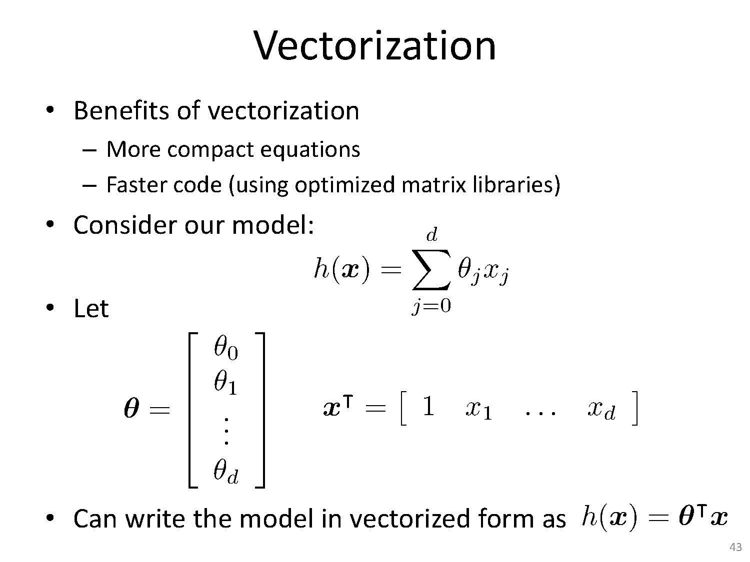

Slide 46
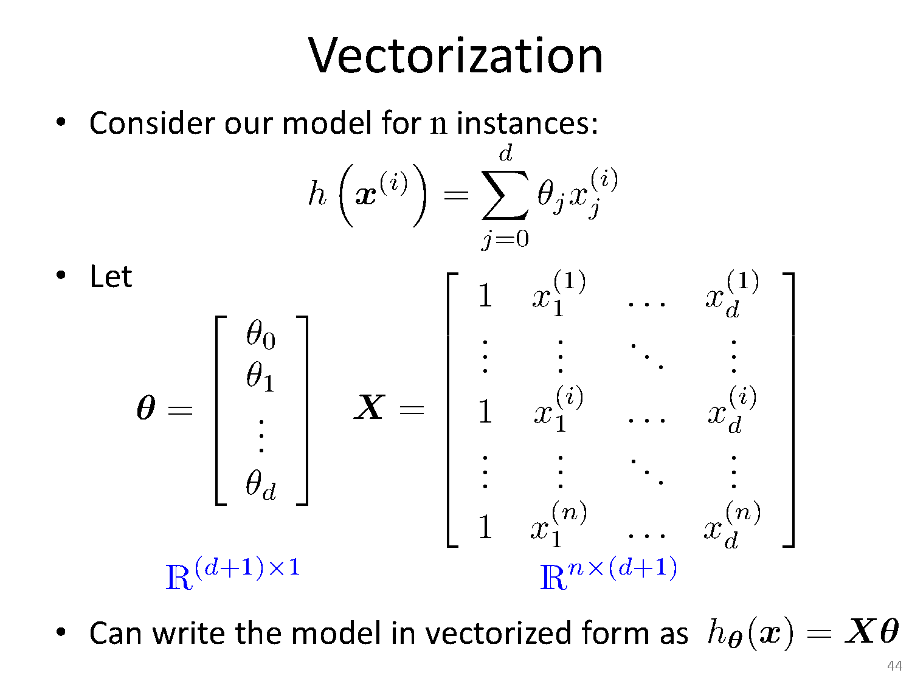

Slide 47


Slide 48


Slide 49


Slide 50


Slide 51
Python Implementation
Scikit learn provides you two approaches to linear regression:
LinearRegression object uses Ordinary Least Squares solver from scipy, as LR is one of two classifiers which have closed form solution. Learn this model by just inverting and multiplicating some matrices.
SGDClassifier which is an implementation of stochastic gradient descent, very generic one where you can choose your penalty terms. To obtain linear regression you choose loss to be L2
There is no "typical gradient descent" because it is rarely used in practise.

Slide 52
Python Implementation Demo

Slide 53
Bayesian linear regression

Slide 54
Bayesian analysis
Bayesian analysis will show that
under certain assumptions any learning algorithm that minimizes the squared error between the output hypothesis predictions and the training data will output a maximum likelihood hypothesis

Slide 55
Maximum likelihood and least-squared error hypotheses
A set of m training examples is provided, where the target value of each example is corrupted by random noise drawn according to a Normal probability distribution.
Each training example is a pair of the form
(x_{i}, d_{i}) where d_{i} = f (x_{i}) + e_{i}. Here f (x_{i}) is the noise-free value of the target function and e_{i} is a random variable representing the noise.
values of the e_{i} are drawn independently and that they are distributed according to a Normal distribution with zero mean

Slide 56




Choose parameterized form for P(Y|X; θ)
Y
X
Assume Y is some deterministic f(X), plus random noise
where
Therefore Y is a random variable that follows the distribution
and the expected value of y for any given x is f(x)

Slide 57



Consider Linear Regression
E.g., assume f(x) is linear function of x
Notation: to make our parameters explicit, let’s write

Slide 58



Training Linear Regression : Maximum Conditional Likelihood Estimate (MCLE)
How can we learn W from the training data?
Learn Maximum Conditional Likelihood Estimate!
where

Slide 59



Training Linear Regression: MCLE
Learn Maximum Conditional Likelihood Estimate
where
so:

Slide 60

Training Linear Regression: MCLE, MLE

Slide 61



Training Linear Regression
Maximum Conditional Likelihood Estimate is equivalent to minimizing the squared error loss
Can we derive gradient descent rule for training?

Slide 62
Regression – What you should know
Under general assumption
We can use gradient descent as a general learning algorithm
as long as our objective function is differentiable wrt W
though we might learn local optima
Almost nothing we said here required that f(x) be linear in x

Slide 63


Slide 64
Linear Basis Function Models

Slide 65

Linear Basis Function
Simplest linear model for regression is one that involves a linear combination of the input variables
y(x,w)=w₀ +w₁x₁ +...+w_{D}x_{D}
Extend the class of models by considering linear combinations of ﬁxed nonlinear functions of the input variables, of the form
y(x,w)=w₀ + $\sum_{j=1}^{M−1}{\text{w}\text{j}\text{φ}\text{j}\text{(}\text{x}\text{)}}$
where $\text{φ}\text{j}\text{(}\text{x}$) are known as basis functions.
By denoting the maximum value of the index j by M −1, the total number of parameters in this model will be M.

Slide 66


Slide 67

Basis Functions

Slide 68

Basis Functions

Slide 69


Slide 70
Extra Reading References
https://stackabuse.com/solving-systems-of-linear-equations-with-pythons-numpy/
https://scikit-learn.org/stable/modules/generated/sklearn.model_selection.train_test_split.html
https://www.datatechnotes.com/2019/02/regression-model-accuracy-mae-mse-rmse.html
https://www.geeksforgeeks.org/python-linear-regression-using-sklearn/
Funny but simple explanation about bias and variance
https://www.youtube.com/watch?v=EuBBz3bI-aA
Gradient Descent
https://machinelearningmastery.com/gentle-introduction-mini-batch-gradient-descent-configure-batch-size/
https://textbooks.math.gatech.edu/ila/least-squares.html
https://towardsdatascience.com/batch-mini-batch-stochastic-gradient
https://www.coursera.org/lecture/machine-learning/gradient-descent-8SpIM-descent-7a62ecba642a
Skewness or kurtosis
https://medium.com/dev-genius/skewness-and-kurtosis-in-data-science-aa795ba4b453

Slide 71
In our next session
We will cover:
Bias-variance decomposition (3.2 Bishop)
Tom Mitchell - Chapter 3
Decision Tree
Handling overfitting
Continuous values
Missing Values
Random Forest

